Slide 1
Light Shower: A Poor Man’s Light Stage Built with an Off-the-shelf Umbrella and Projector
Makoto Okabe
Kenshi Takayama
Takashi Ijiri
Takeo Igarashi
The University of Tokyo
Notes:
Hello, we are makoto okabe and kenshi takayama from the university of tokyo.

Slide 2
Background
Composite is important for movie making
Simple chroma-key is not enough
Notes:
Composite is important and powerful tool for movie making.
However simple chroma-key is not enough to create a beautiful composite.
For example, here is a composite result using blue screen key, but the lighting conditions of the foreground actor and the background image are different, so the resulting composite is strange, because it’s photometrically inconsistent.

Slide 3


Background
Composite is important for movie making
Simple chroma-key is not enough
Photometrically inconsistent
Notes:
Composite is important and powerful tool for movie making.
However simple chroma-key is not enough to create a beautiful composite.
For example, here is a composite result using blue screen key, but the lighting conditions of the foreground actor and the background image are different, so the resulting composite is strange, because it’s photometrically inconsistent.

Slide 4
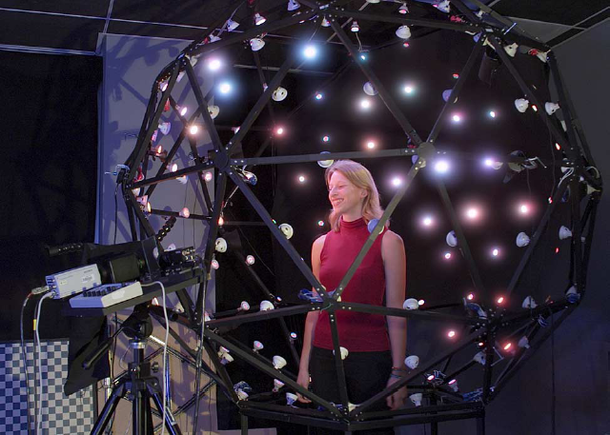
Previous Work
Light Stage simulates virtual lighting environment around an actor [Debevec et al., 2002]
Notes:
To solve this problem, Light Stage system is used.
“based on the background image”

Slide 5
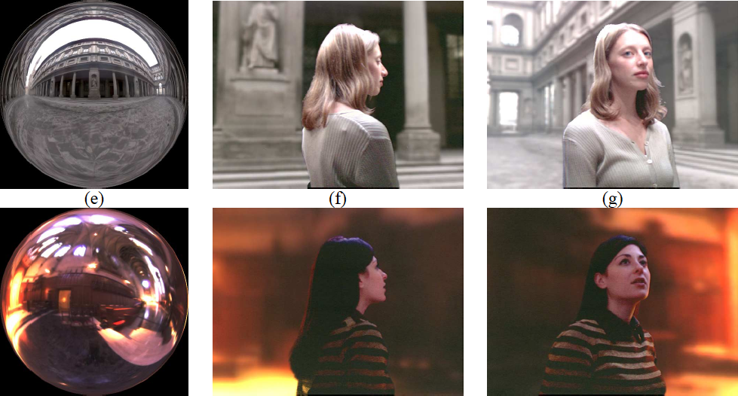
Previous Work
Light Stage simulates virtual lighting environment around an actor [Debevec et al., 2002]
Beautiful composites can be made
Notes:
Now the lighting conditions are consistent, so the resulting composites are beautiful.
Our first motivation is simply that

Slide 6
Previous Work
Light Stage simulates virtual lighting environment around an actor [Debevec et al., 2002]
Beautiful composites can be made
Really Cool!!! ☺
Notes:
We also want to use this cool system to create a beautiful composite.
And then, we tried buliding this system, However, there was a big problem, that is,

Slide 7
However, …

Slide 8
It’s too expensive!
for poor students

Slide 9
It’s too expensive!
for poor students

Slide 10
It’s too expensive!
for poor students

Slide 11
It’s too expensive!
for poor students (us)
Notes:
So we have tried several solutions.

Slide 12
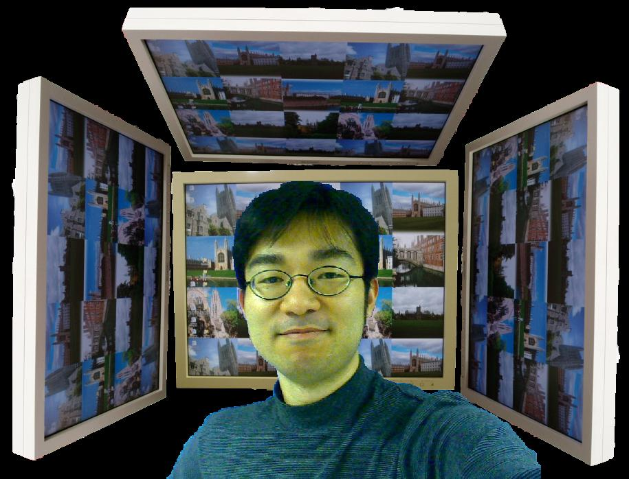
failure 1 - LCD displays
Notes:
First of all, we built a system like this, in which we use LCD displays as environmental lights around a face.

Slide 13
failure 1 - LCD displays
Weak lights

Slide 14
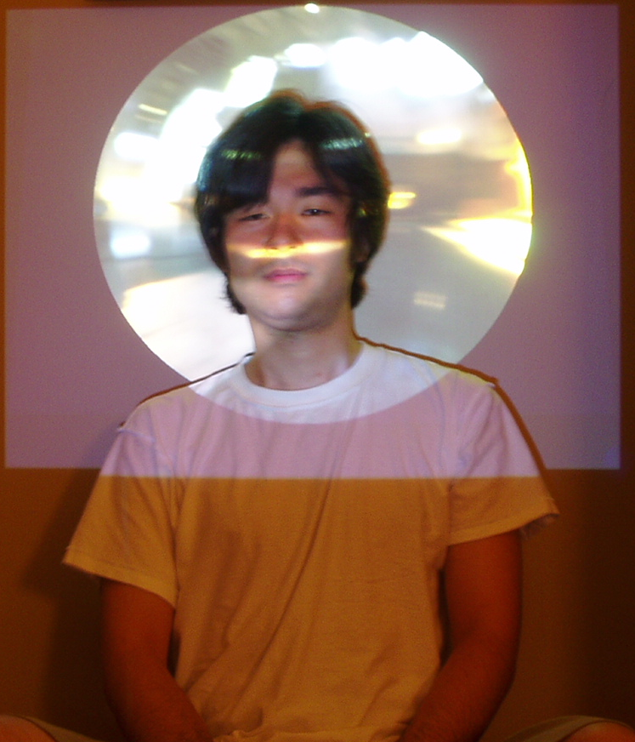
failure 2 - direct projection
Notes:
We just project an image on the actor’s face using a projector, but the actor felt too dazzling.

Slide 15
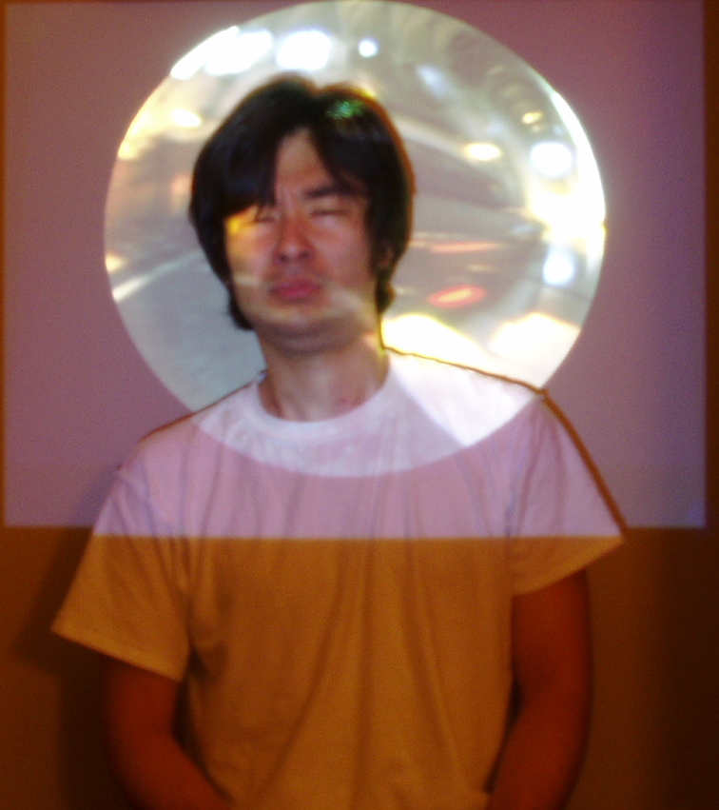
failure 2 - direct projection
Notes:
We just project an image on the actor’s face using a projector, but the actor felt too dazzling.

Slide 16
failure 2 - direct projection
No environment lighting
Notes:
We just project an image on the actor’s face using a projector, but the actor felt too dazzling.

Slide 17
Our Approach
Notes:
Finally, we could find a reasonable solution, that is “Light Shower” system with a projector and THIS UMBRELLA!!!
このタイミングで傘を見せる。

Slide 18

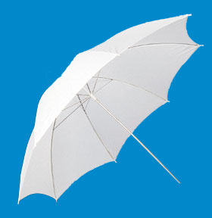
Our Approach
We use off-the-shelf umbrella
Notes:
We’d like to talk about this cheap system from now on.

Slide 19
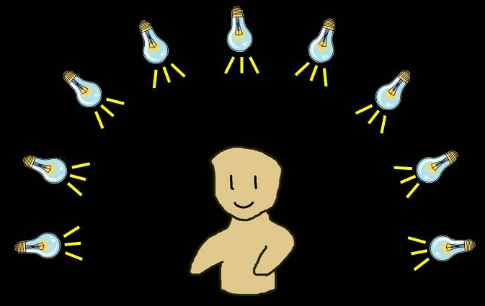
Principle
Light stage

Slide 20
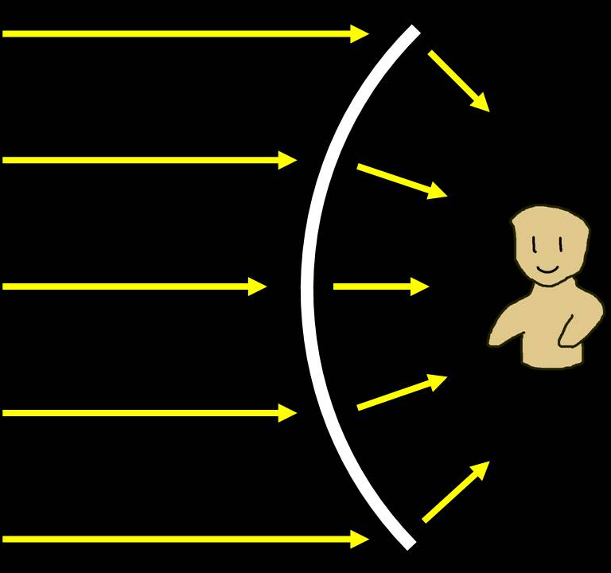
Principle
Light stage
Light shower

Slide 21
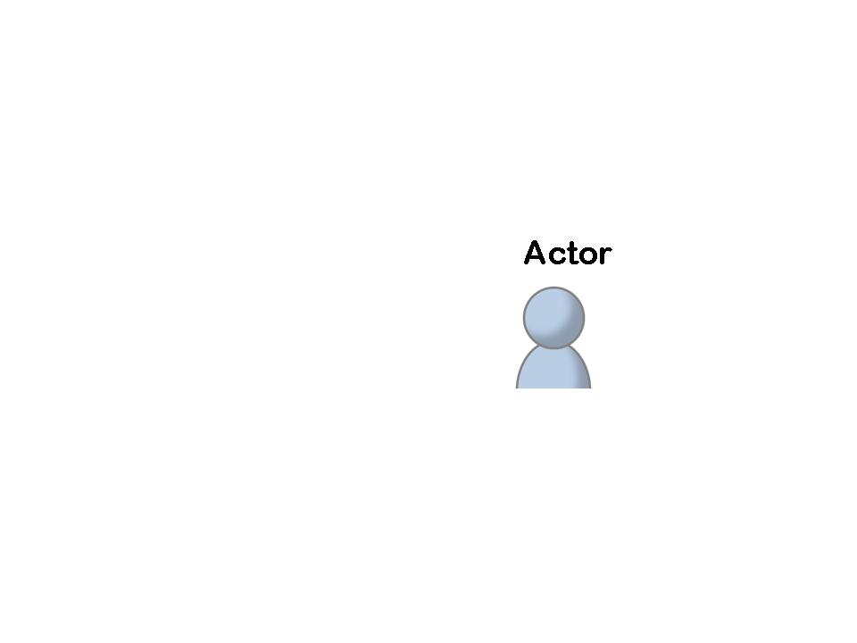
Our Approach
Light Stage with off-the-shelf materials

Slide 22
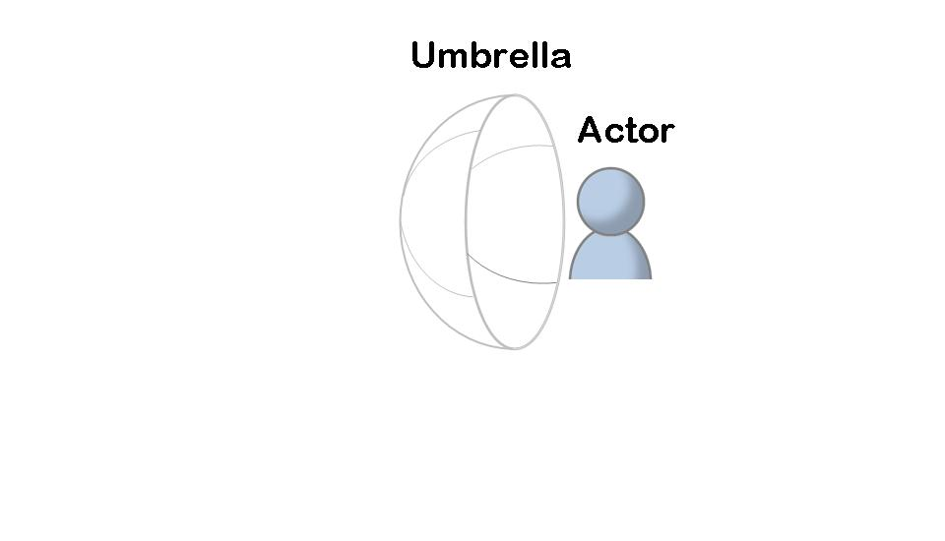
Our Approach
Light Stage with off-the-shelf materials
umbrella

Slide 23
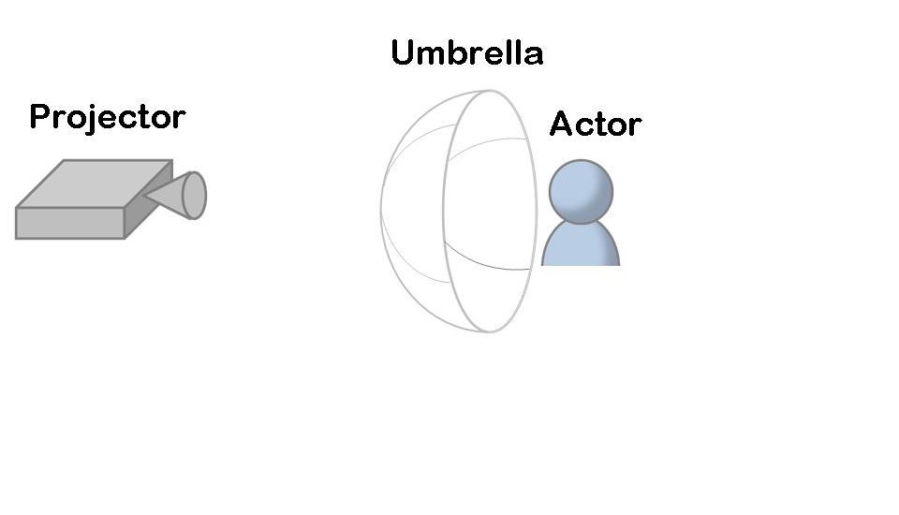
Our Approach
Light Stage with off-the-shelf materials
umbrella and projector

Slide 24
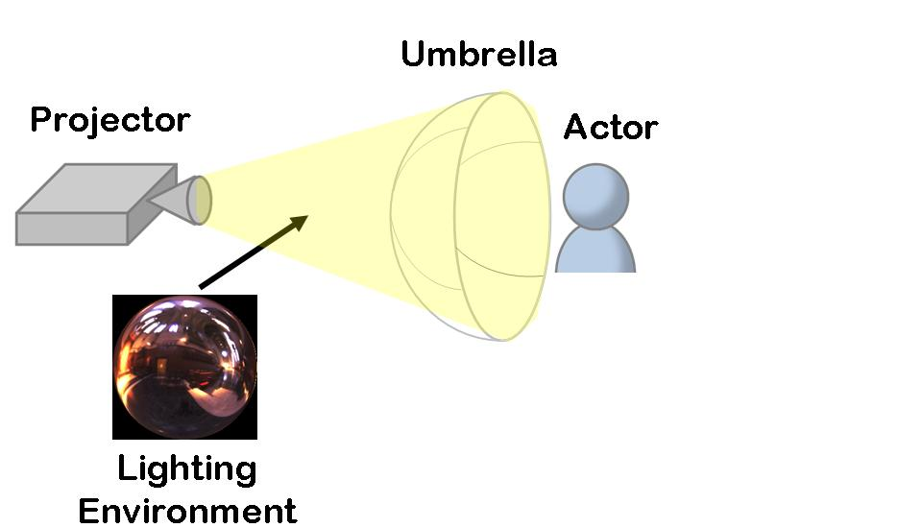
Our Approach
Light Stage with off-the-shelf materials
umbrella and projector

Slide 25
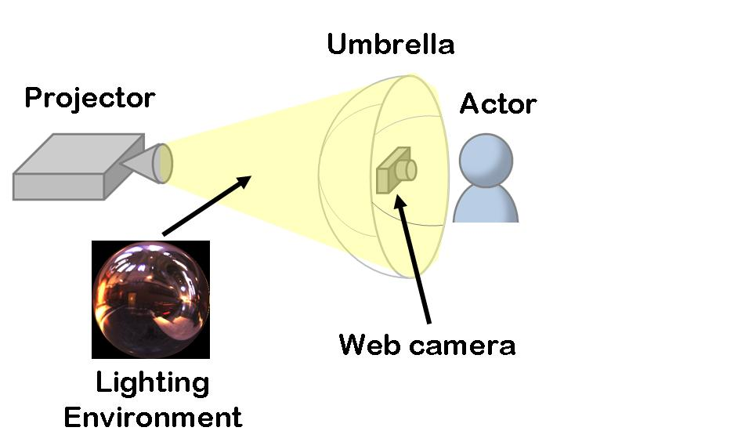
Our Approach
Light Stage with off-the-shelf materials
umbrella and projector
web camera

Slide 26
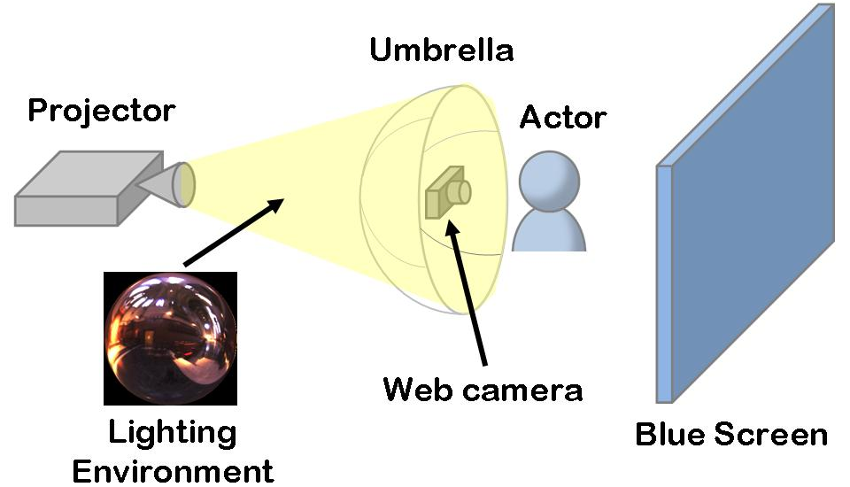
Our Approach
Light Stage with off-the-shelf materials
umbrella and projector
web camera and blue screen

Slide 27
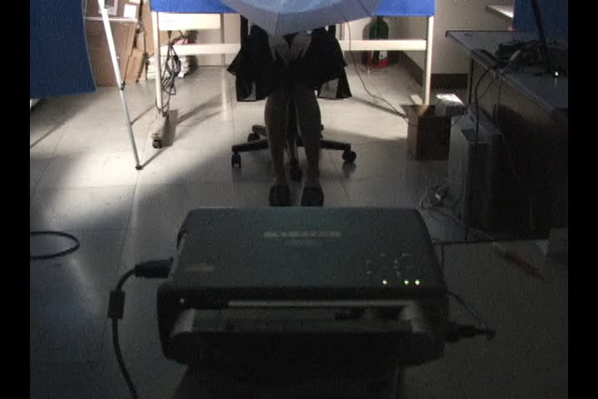
Recording

Slide 28
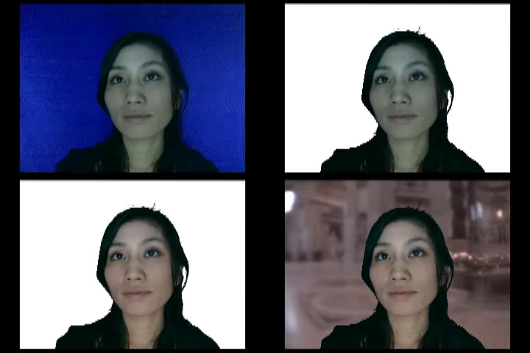
Composite Process
Post-processing using Adobe Premiere

Slide 29
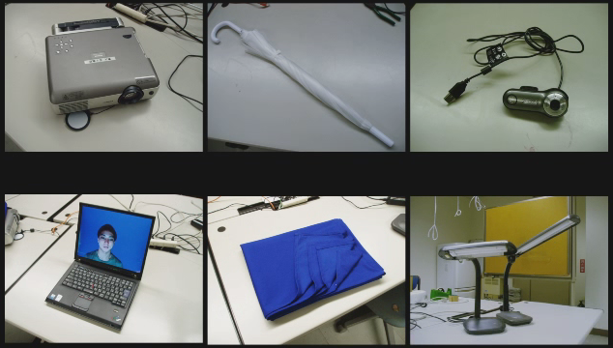
Apparatus

Slide 30
Apparatus
RENT
RENT
RENT
RENT
RENT
Notes:
A blue table cross.

Slide 31
Apparatus
RENT
$ 5
RENT
RENT
RENT
RENT

Slide 32
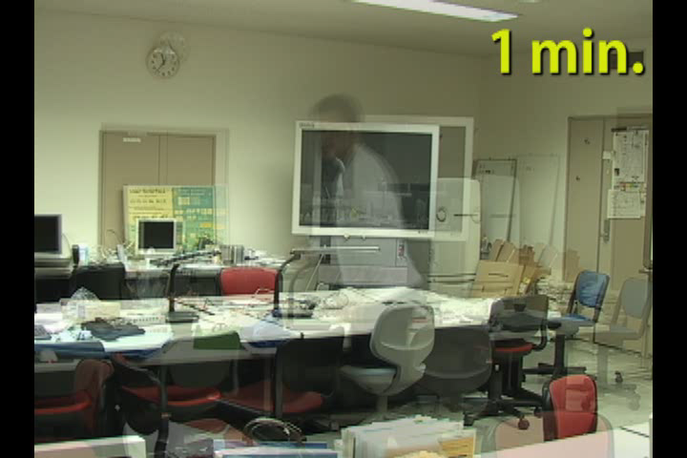
Apparatus - how to build
Notes:
No practice.とか。

Slide 33
Comparison
Estimated cost
Previous Work
$$$･･･$
Light Shower
$ 5
Notes:
プライスをチェック！

Slide 34
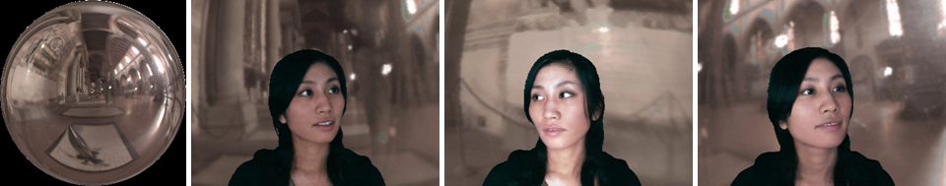
Results
Live action

Slide 35
Another advantage
Live action with specular objects
discrete

Slide 36
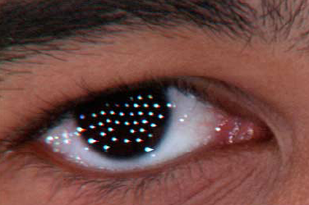
Another advantage
Live action with specular objects
discrete

Slide 37
Another advantage
Live action with specular objects
discrete
continuous

Slide 38
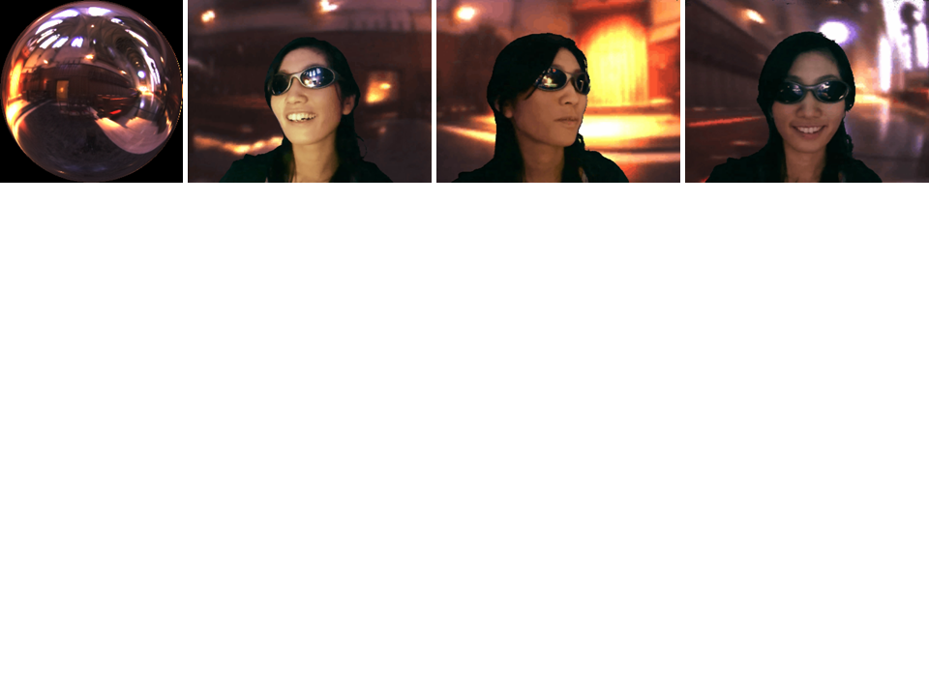
Another advantage
Live action with specular objects
discrete
continuous

Slide 39
Application
Education
Students in media science
Students for movie making

Slide 40
Application
Education
Students in media science
Students for movie making
Low cost movie making

Slide 41
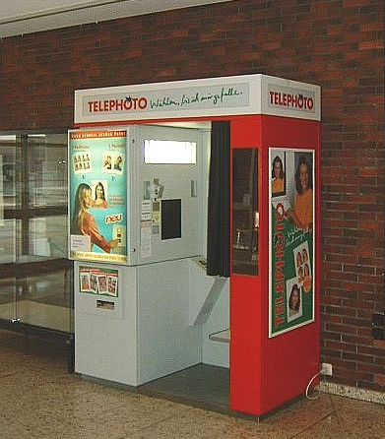
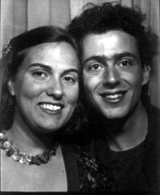
Application
Education
Students in media science
Students for movie making
Low cost movie making
Entertainment
Photo booth

Slide 42
Summary
Inexpensive light stage system
White umbrella
Projector
27 minutes to build
Useful for face relighting
with specular objects
Notes:
傘とコンポジット結果

Slide 43
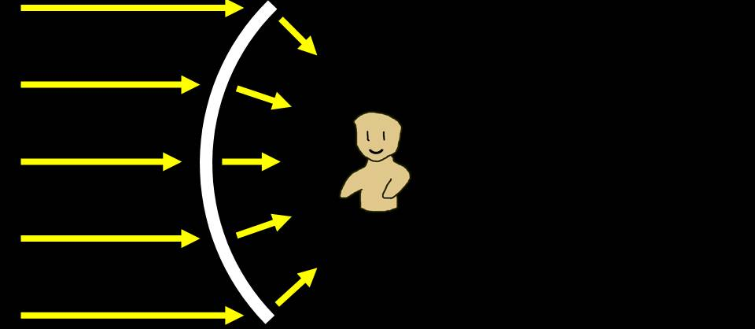
Future Work
Method for an enclosed environment

Slide 44
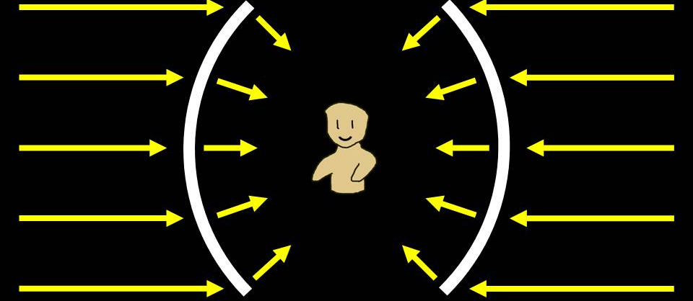
Future Work
Method for an enclosed environment

Slide 45
Future Work
Method for an enclosed environment
Some calibration method

Slide 46
Future Work
Method for an enclosed environment
Some calibration method
More applications for CV field
Capturing BRDF, BTF, etc…

Slide 47
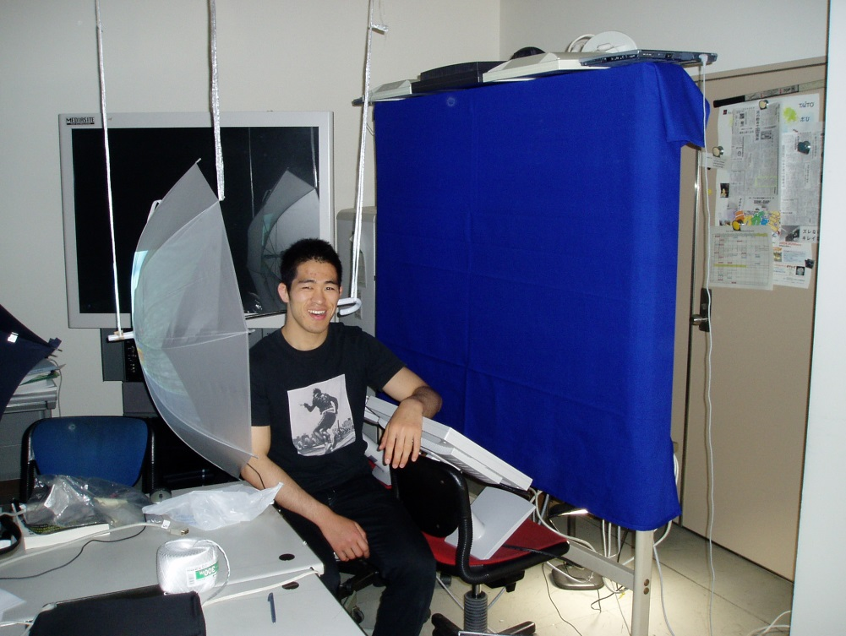
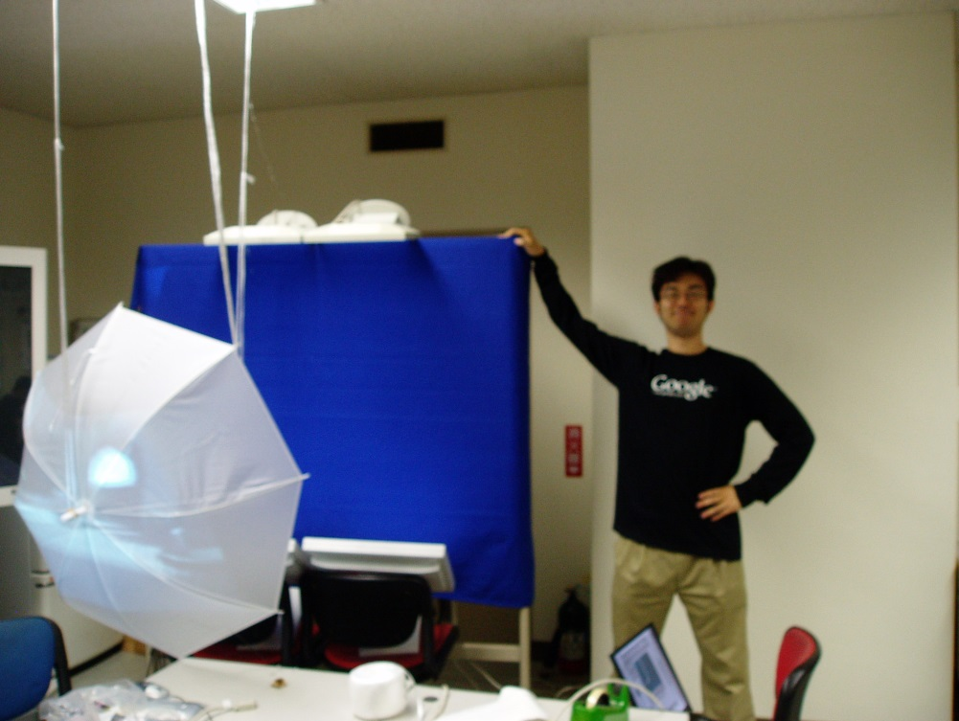
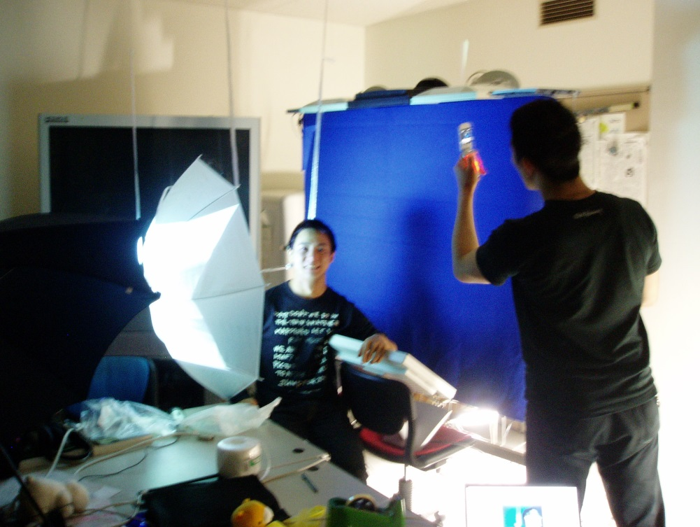
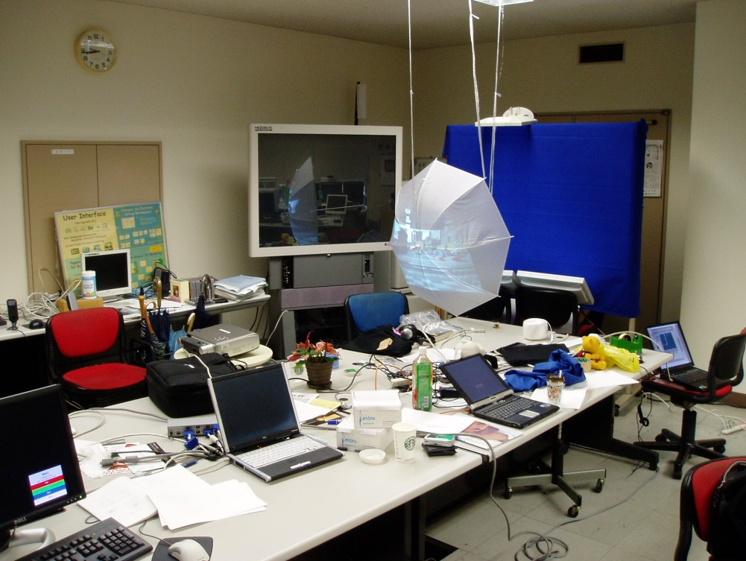
Thank you!

